Slide 1
IBM Data Science Capstone

Slide 2
The Battle of Neighborhoods
Finding the best place to build Hotel without Restaurant.
Indonesia
West Java Province and East Java Province

Slide 3
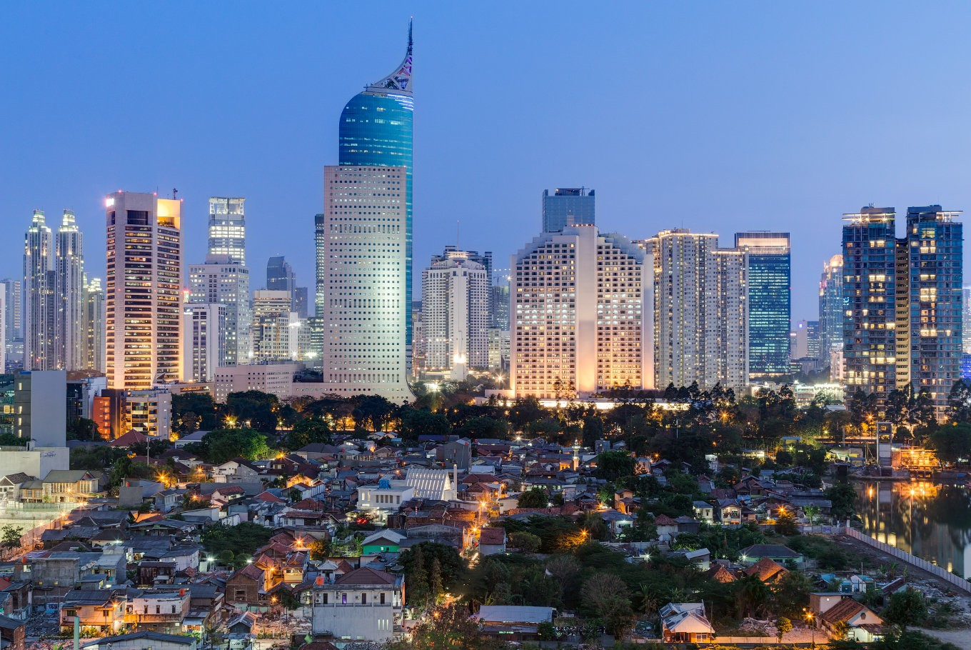

Slide 4
Introduction
Business Problem
In this project we will try to find the optimal location for a hotel with lodging facilities only without a restaurant. Specifically, this report will be addressed to stakeholders who are interested opening Hotel in West Java Province Hotel and East Java Province, Indonesia.
Because there are many hotels in West Java Province and East Java province, we will try to provide a busy location with restaurants, sports bars, basketball courts, food and drink shops and entertainment areas. We are also very interested because hotel visitors will more freely choose the food menu around the hotel. We also prefer a location that is as close as possible to the city center, assuming that the first conditions are met.
We will use the power of our data science to generate some of the environments that best fit this criterion. The advantages of each region will then manifest the business clearly so that the best outcome can be chosen by the stakeholders.

Slide 5
Purpose of this Project
The dataset combines city coordinates in West Java and East Java. The datasets does not include the venues within these locations. With venue information, it would be easy to find out more information about the neighborhoods. For example, how many sports bars and restaurants there are, and any basketball courts or playgrounds? We could also need to find out about any banks and food and drink shops? It would be better to understand or make good choices about where the hotel will be built
Next, the reason for this project is to, algorithmically, way to use location coordinates and mark each data point into the environment in two Provinces namely West Java and East Java in Indonesia. The algorithm used is k-means clustering. The main idea is to determine neighborhood with venues clustered around each other so that one can make a decision on the right neighborhood to chose based on the proximity of amenities and venues to each other.

Slide 6
K-means Clustering
The k-means clustering algorithm is an unsupervised clustering technique searches for a pre-determined number of clusters within an unlabeled multidimensional dataset. It accomplishes this using a simple conception of what the optimal clustering looks like:
The "cluster center" is the arithmetic mean of all the points belonging to the cluster.
Each point is closer to its own cluster center than to other cluster centers in the dataset.
The two assumptions above are presumably the basis of the k-means model.

Slide 7
Data
Based on definition of our problem, factors that will influence our decission are:
number of existing restaurants, sports bars, basketball courts, food and drink shops and entertainment areas in the neighborhood
number of and distance to restaurants, sports bars, basketball courts, food and drink shops and entertainment areas in the neighborhood, if any
distance of neighborhood from city center
We decided to use regularly spaced grid of locations, centered around city center, to define our neighborhoods.
Following data sources will be needed to extract/generate the required information:
The dataset for this project consists of information regarding the cities in Indonesia obtained from https://simplemaps.com/data/world-cities. Specifically, the data contain: City, city_ascii, lat, lng , country, iso2, iso3, admin_name, capital, population and id.
I used business intelligence tools for geocoding the data to obtain the correct coordinates
The data was then exported and converted into a .json, read into a pandas dataframe and sliced into West Java and East Java Province data for use in the project.

Slide 8
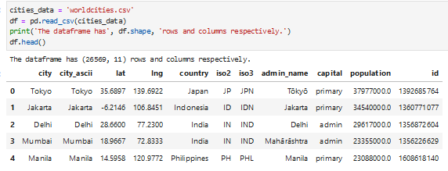
Data

Slide 9
Methodology
Exploratory Analysis
Exploratory analysis was performed by examining tables and plots of the download data.
This was used to:
1. Segment the data into Cities in West Java and East Java Province
2. identify missing values, verify the quality of the data
3. determine likely approaches to modelling, which might best yield to good clustering.
Segmenting and Slicing, and visualizing the data
An important part of cluster modelling is the careful selection of the variables of available
data. A prerequisite of the study is that the foursquare API is used to collect the venue
information. Hence it is very important that the dataset for this work includes the coordinates
of the cities to be studied. Segmentation and slicing of the data resulted in Table 1. The
subjects included in the data for analysis includes:
City, city_ascii, lat, lng , country, iso2, iso3, admin_name, capital, population and id

Slide 10
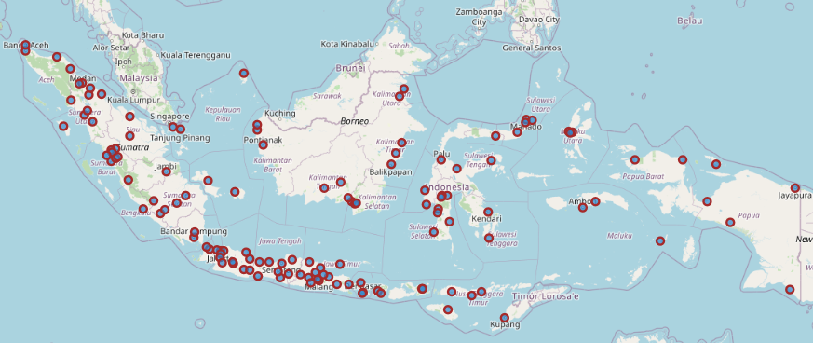
Segmenting Indonesia Data​

Slide 11
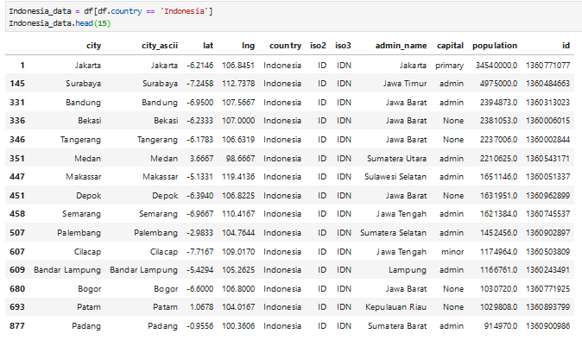

Slide 12
Folium
Folium is a powerful python library that builds on the data wrangling strengths of the python ecosystem and the mapping strengths of the Leaflet.js library. Generally, data is manipulating in Python, and then visualize it in on a Leaflet map via Folium.

Slide 13
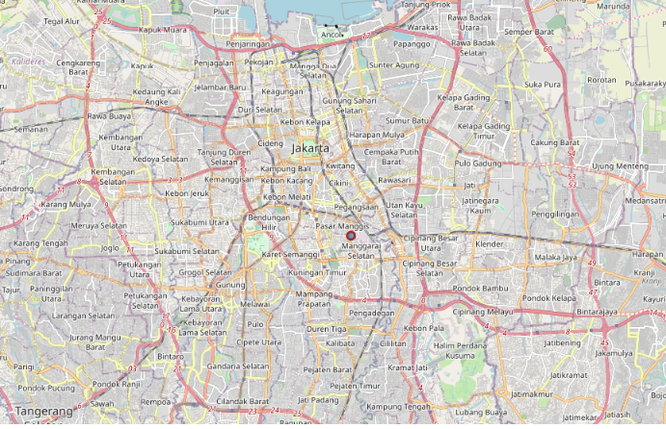
Example Folium map of Jakarta

Slide 14
Neighborhood Exploration and Cluster – West Java and East Java
For the neighborhood exploration, the Foursquare API was used. The get request was deployed on the Foursquare URL to get the category types of venues limiting the number of venues to 100 within a 500 radius.Because the aim of the project is to determine the cluster of venues in the neighborhoods, one-hot encoding was performed on the venue categories to get dummies for each venue. That is to say, the venues were coded into 0s and 1s. The result was then grouped by neighborhood by taking the mean of the frequency of occurrence of each category.

Slide 15
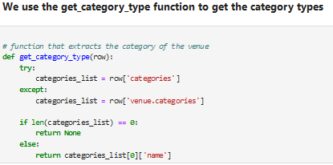
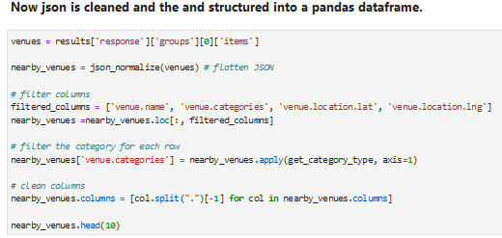

Slide 16
Using the Foursquare API, the venues within the neighborhoods in both West Java and East Java Province in a vast number of outcomes. The radius defined for the venue returned venues with 677 rows and 7 columns for both West Java and East Java. The one-hot encoding produced a total number of 677 and 128 rows and columns for West Java and East Java Province respectively. Tables below show the results of the top 3 venues in each neighborhood venues for both West Java and East Java Province was grouped by neighborhood.

Slide 17
Cluster of Neighborhoods in West Java and East Java.
For the clustering of venues categories in the neighborhoods, the k-means cluster was employed. to cluster the neighborhood into 4 clusters. The k-means clustering machine learning algorithm is an unsupervised clustering technique searches for a pre-determined number of clusters within an unlabeled multidimensional dataset. It accomplishes this using a simple conception of what the optimal clustering looks like:
The "cluster center" is the arithmetic mean of all the points belonging to the cluster.
Each point is closer to its own cluster center than to other cluster centers in the dataset.
The two assumptions above are presumably the basis of the k-means model. To be able to produce the clusters and visualize it on a map, the sliced West Java and East Java data were merged with the grouped venue data. This was done so that the coordinates form the sliced data can aid in visualizing the clusters on a map.

Slide 18
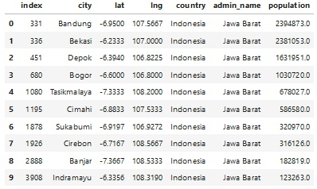
Result
West Java Data (jabar_data)

Slide 19
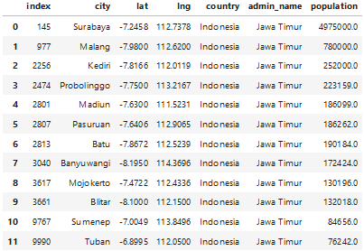
East Java Data (jatim_data)

Slide 20
Since the aim of the project is to cluster the neighborhoods, the k-means algorithm is applied to the onehot encoded venue dataset, assuming there are 4 different clusters. The tables below show the neighborhood and the cluster labels assigned to it after the k-means algorithm was applied. Cluster label ‘0’ represents the 1st cluster and ‘3’ the 4th cluster. This series of plots shows the data for each pair of

Slide 21
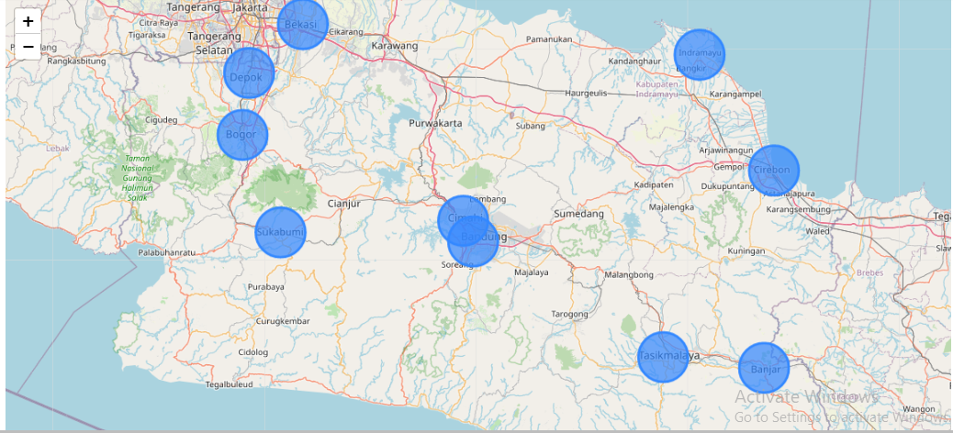
Neighborhood cluster for West Java

Slide 22
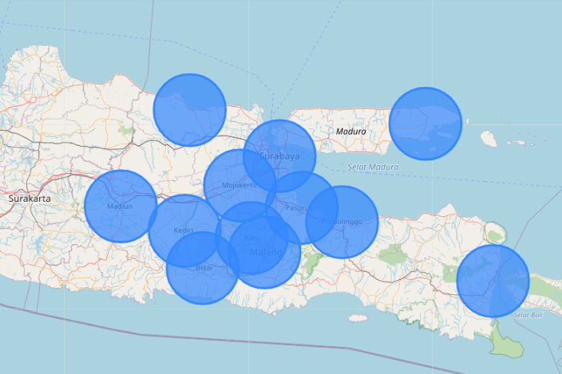
Neighborhood cluster for East Java

Slide 23
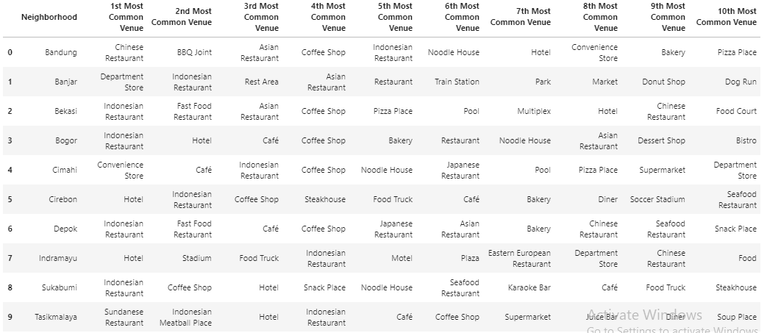
West Java most common venues

Slide 24
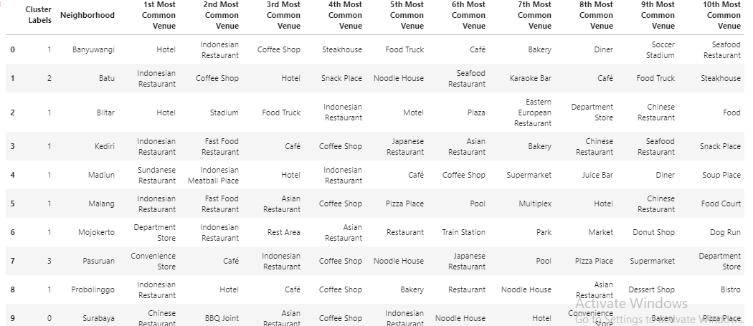
East Java most common venues

Slide 25
From the exploratory analysis, it seems a lot of the neighborhoods are in the cluster for both
West Java and East Java Province. When we look at the clusters for West Java, it becomes
clear that the first two most common venues in the neighborhoods contain a lot of mixed
amenities: Chinese Restaurant, Indonesian Restaurant, Fast Food Restaurant, Sundanese Restaurant, Snack Place, Steakhouse, Japanese Restaurant, Fast Food Restaurant, Pool, Pizza Place, Karaoke Bar, Eastern European Restaurant. Again, looking at that of East Java Province, we have: Convenience Store, Coffee Shop, Department Store, Juice Bar, Noodle House, Japanese Restaurant, Soup Place, Park, and Donut Shop.

Slide 26
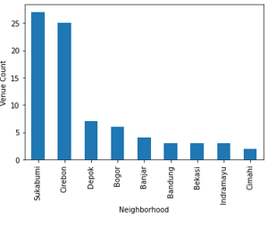
West Java Venue Count Bar graph

Slide 27
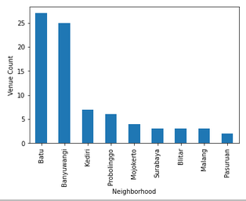
East Java Venue Count Bar graph

Slide 28
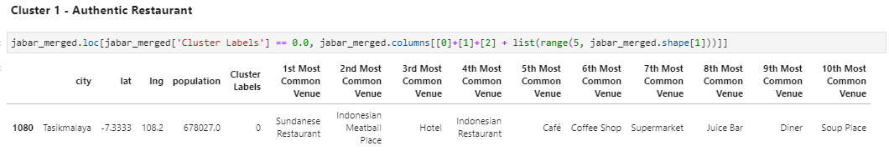
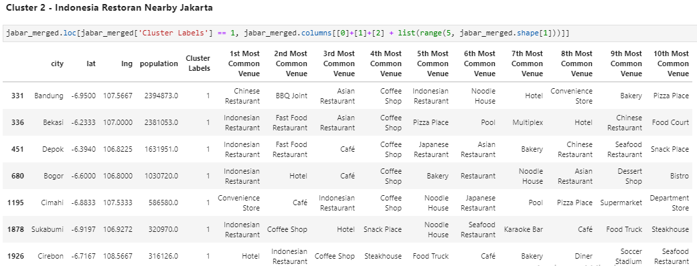
Cluster in West Java

Slide 29
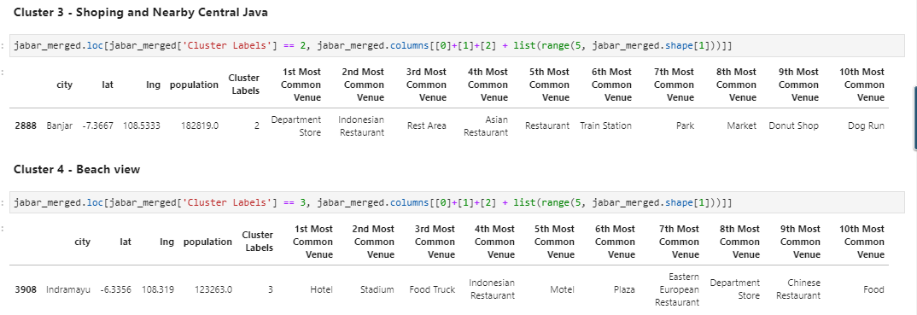
Cluster in West Java

Slide 30
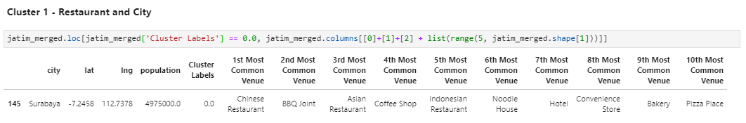
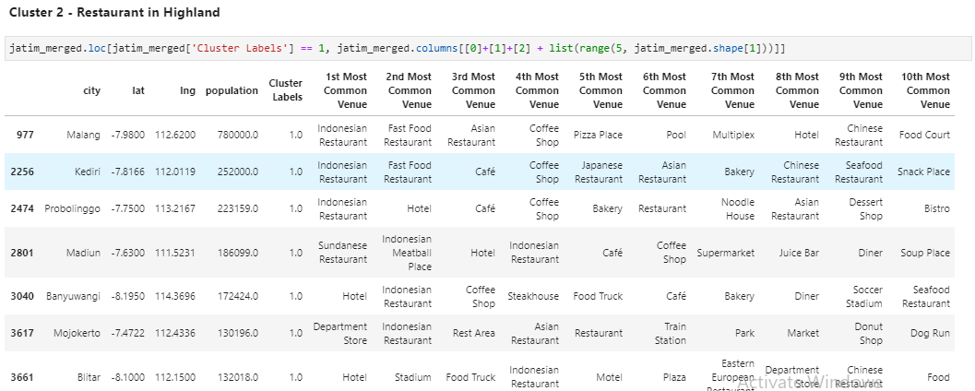
Cluster in East Java

Slide 31
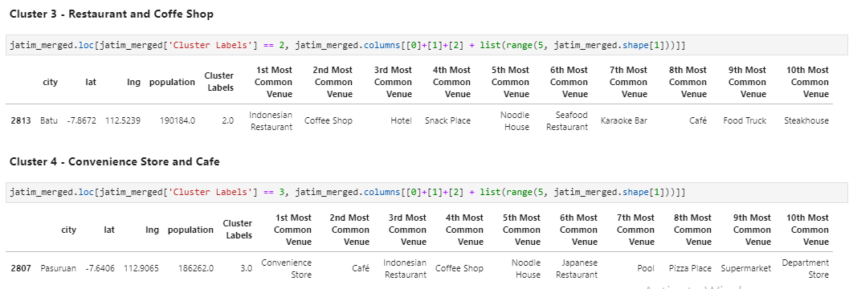
Cluster in East Java

Slide 32
Discussion
So, the question is where one should consider establishing a hotel in West Java and East Java Provinces?
For West Java, Cluster 1 covering the city of Tasikmalaya will be selected by a stakeholder to build a hotel with authentic Sundanese nuances, because there are several restaurants around it including a Sundanese restaurant. Cluster 2 covering several cities will be chosen because the area is close to Jakarta and surrounded by many Indonesian restaurants, here it is more suitable as an alternative for people to go to Jakarta. Cluster 3 includes banjar which is somewhat less suitable for building hotels because there are fewer restaurants. Cluster 4 covers the city of Indramayu which is close to the beach, here there is a potential to build a hotel with a beach style.
For East Java, Cluster 1 covering the city of Surabaya will be chosen by a stakeholder to build a hotel with a sparkling city feel, because Surabaya is the second largest city in Indonesia and the capital of the province of East Java. Cluster 2 includes several cities in the highlands, will be chosen because of the cold area and there are a variety of Indonesian restaurants, so as to satisfy the appetite of visitors. Cluster 3 covers Batu City, can be an alternative to the highlands, there are many restaurants and karaoke bars, perfect for people who want to cool off. Cluster 4 covers the city of Pasuruan, here it is suitable for building a hotel with a beach style because it is not as busy as Surabaya, suitable for people who want to avoid noisy atmosphere.

Slide 33
Discussion
The purpose of this job is to provide the necessary facilities to help people decide where to build a hotel if they think about it. Using public data sets obtained from the web, I was able to overcome several factors by analyzing the environment in the two main Provinces of Indonesia, West Java and East Java based on the spatial distribution of places in the selected neighborhoods.
My analysis shows that using the folium-python library which helps build fast interactive data visualizations and the Foursquare API for environmental data collection, it is feasible to segment data for neighboring cities based on a known and accepted machine learning technique - the K-Means Algorithm. These results should be considered bound within the scope of the data set used, as no information is available about their origin. The results will be of interest to both business people and people aiming to compare different environments when thinking about staycation in different environments, given the ease of accessing multiple places in a clustered setting.
Of course there is still a lot of room for improvement. For example, obtaining more than the current neighborhood location to analyze and classify wide expanses of geographic settings. We were also able to use and analyze crime data - publicly available in the two provinces - to help provide sufficient room for decision-making regarding the selection of sites to relocate. This information may be very useful because we certainly don't want to do it. living in a crime-ridden environment. While the approach used here may not be robust, it does demonstrate the usefulness of environmental data analysis.

Slide 34
Thank You

